Slide 1
NLH Update

Slide 2
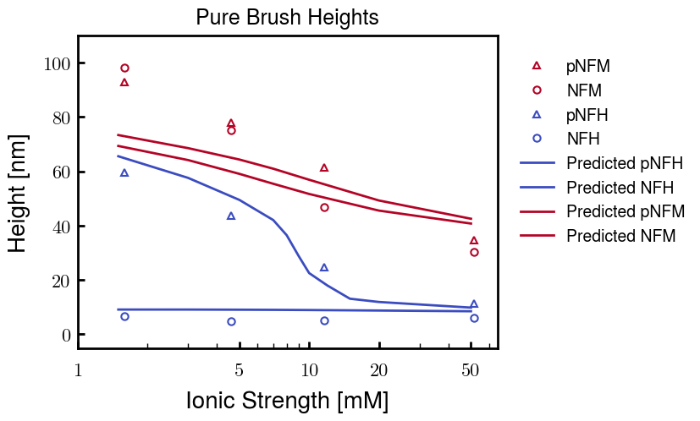
Although the height for pNFM is too short for low Cs, these curves are the best fit

Slide 3
Analysis of other pNFM fitting paramters

Slide 4
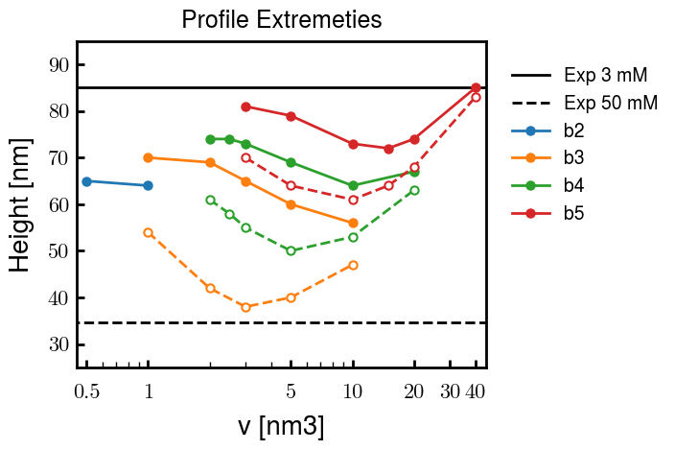
Analysis of other b and v values for pNFM: Comparison of heights at 3 mM (solid lines) and 50 mM (dashed)
b = 2.0 nm
b = 3.0, v = 2.0 used for results on prev. slide

Slide 5
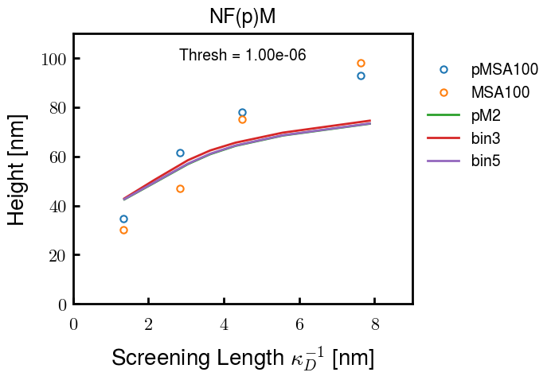
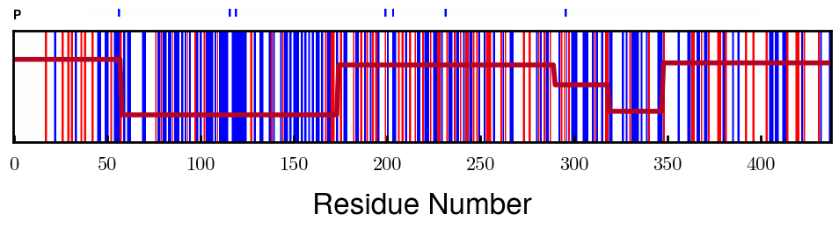
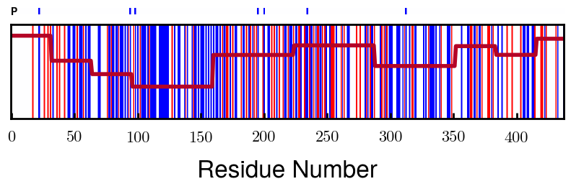
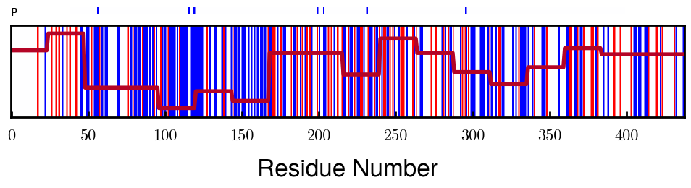
Changing coarse-graining procedure makes little difference
Finer
Note: This is also a demonstration that the coarse-graining is pretty good and finding appropriate the most appropriate blocks

Slide 6
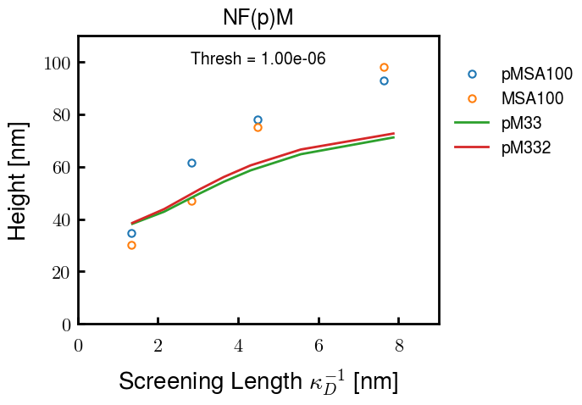
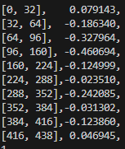
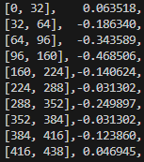
Degree of phosphorylation (-2.0e instead of -1.5e) also similarly little difference (not many units)
Affected blocks

Slide 7
Results

Slide 8
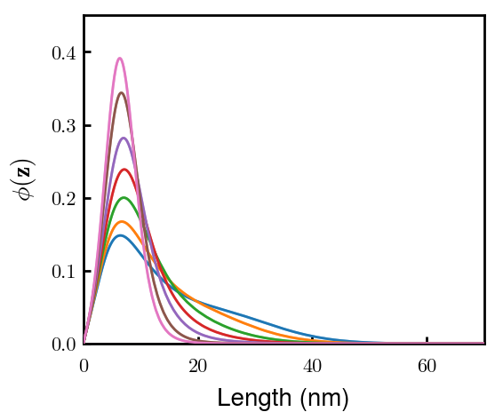
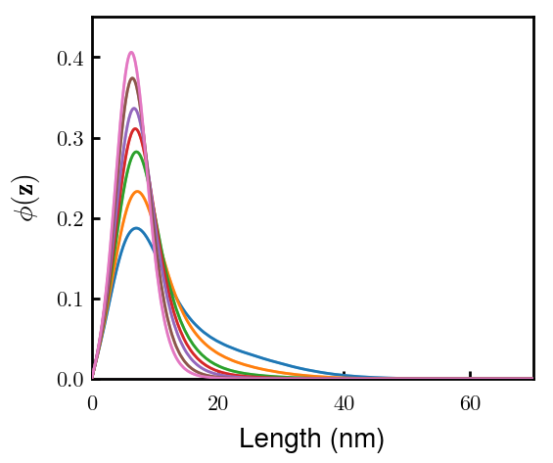
pNFM

